Slide 1
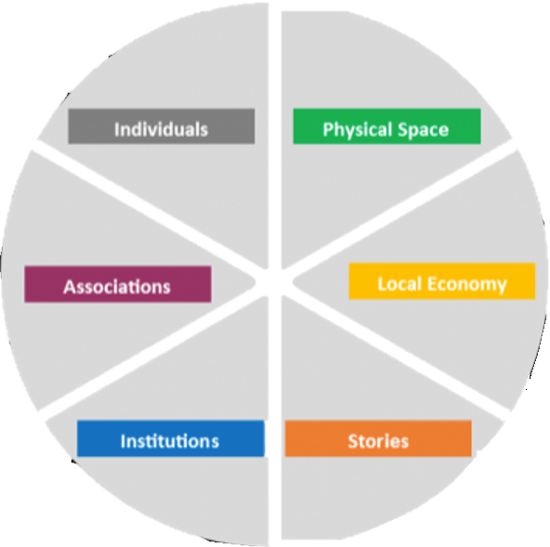
Individuals
Patients at Women’s Care
Family of the Patients
Adolescent Women
Women at UTA
Physical Space
Women’s Care of Mid Cities P.A.
UTA MAC
UTA Health Clinic
Women’s Health Courses at UTA
Nearby Women Centers
Associations
Women’s Care of Mid Cities
Center for Diseases Control and Prevention
Mayo Clinic
Neighboring Women’s Clinic
Local Economy
Women’s Care of Mid Cities
UTA Health Services
Institutions
Women’s Care of Mid Cities
University of Texas at Arlington
Texas Health Resources
Tarrant Country Public Health
Safe Haven of Tarrant County
Stories
Lack of STD knowledge in the patients
How the patients felt being diagnosed
The impact STDs have had on women

